Slide 1
Mountainboard - Lesson 6
Multibody Parts – The Axle and Truck
School’s Name
Teacher’s Name
Date

Slide 2
Multibody Parts
Multibody parts occur when there is more than one continuous solid in the same part file.

Slide 3
Creating a Multibody
Multibodies can be created with the following commands:
  Extruded bosses and cuts
  Revolved bosses and cuts
  Swept bosses and cuts
  Lofted cuts
  Thickened cuts
  Cavities

Slide 4
Combine Command
The Combine command creates a single solid body by:
  Adding
  Subtracting
  Common

Slide 5


Body Addition
Individual bodies add together to form a single body
Adding Bodies 1, 2 and 3
Body 1
Body 3
Result
Body 2

Slide 6
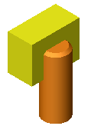

Subtract Bodies
One body volume is removed from the other volume
Subtracting Body 1 from Body 2
Body 1
Result
Body 2

Slide 7
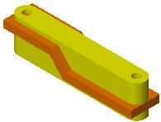
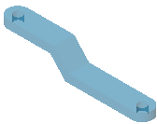
Common Body
The resulting body is the volume common to initial volumes
Also known as an Intersection
Combining Bodies 1 and 2 using Common
Body 1
Body 2
Result

Slide 8
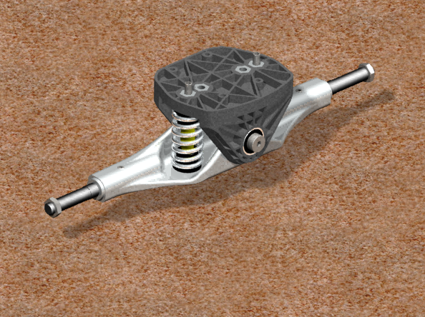
Axle and Truck
Truck
Axle

Slide 9
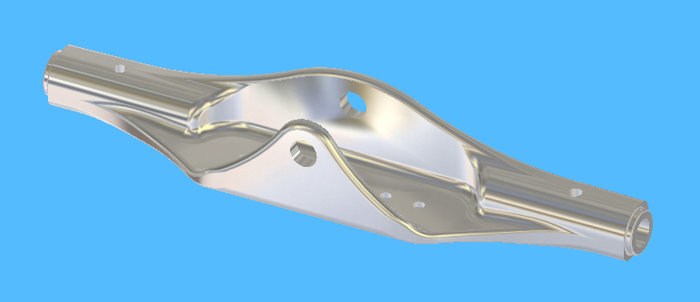
The Axle
The Axle is the connection between the wheels and the Truck.

Slide 10
Design Intent
Connects the wheels to the Truck
Part will be machined from aluminum stock
Part will pivot about the King Pin that goes through the Truck
Mounting must be provided for optional brake system

Slide 11
SolidWorks Simulation
SolidWorks Simulation provides a more in depth FEA package than SolidWorks SimulationXpress
The levels of SolidWorks Simulation software
  SolidWorks SimulationXpress
  SolidWorks Simulation
  SolidWorks Simulation Professional
  SolidWorks Simulation Premium

Slide 12
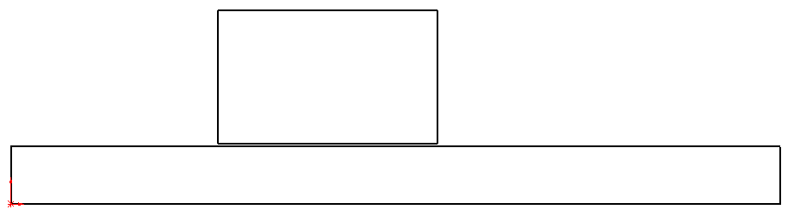
Terms
Some important terms in analysis
Stress
  Tensile Stress
  Shear Stress

Slide 13
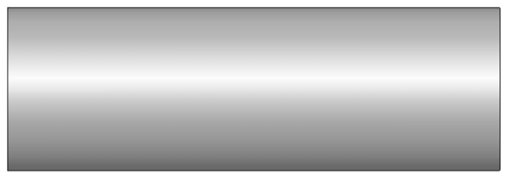
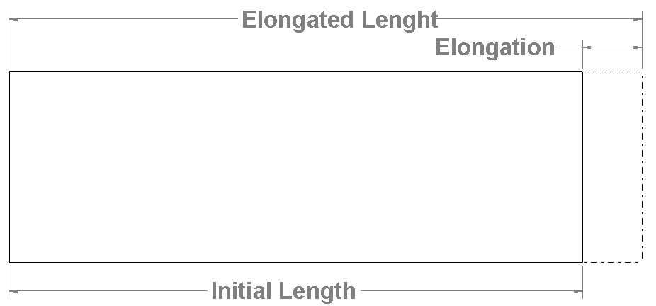
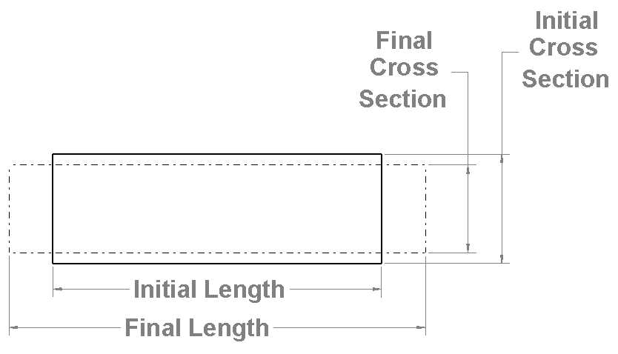
Terms
Strain
  Elongation divided
  by initial length
Modulus of Elasticity
Poison’s Ratio
  Reduction in cross section
  Ratio of axial strain to cross
  section strain

Slide 14
Steps in the FEA Process
Preprocessing
Solution
Postprocessing

Slide 15
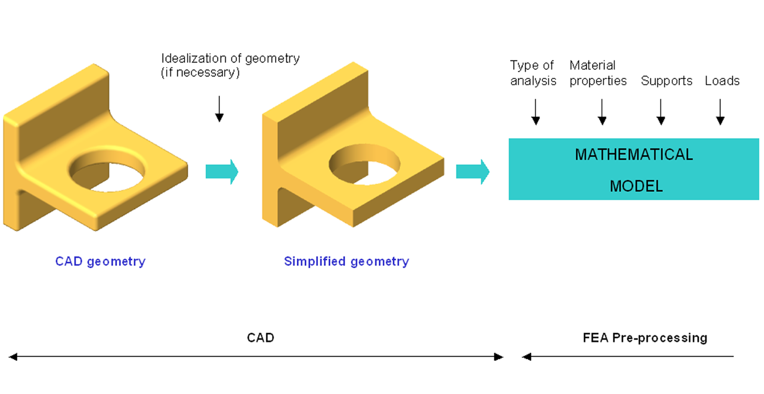
Build Mathematical Model

Slide 16
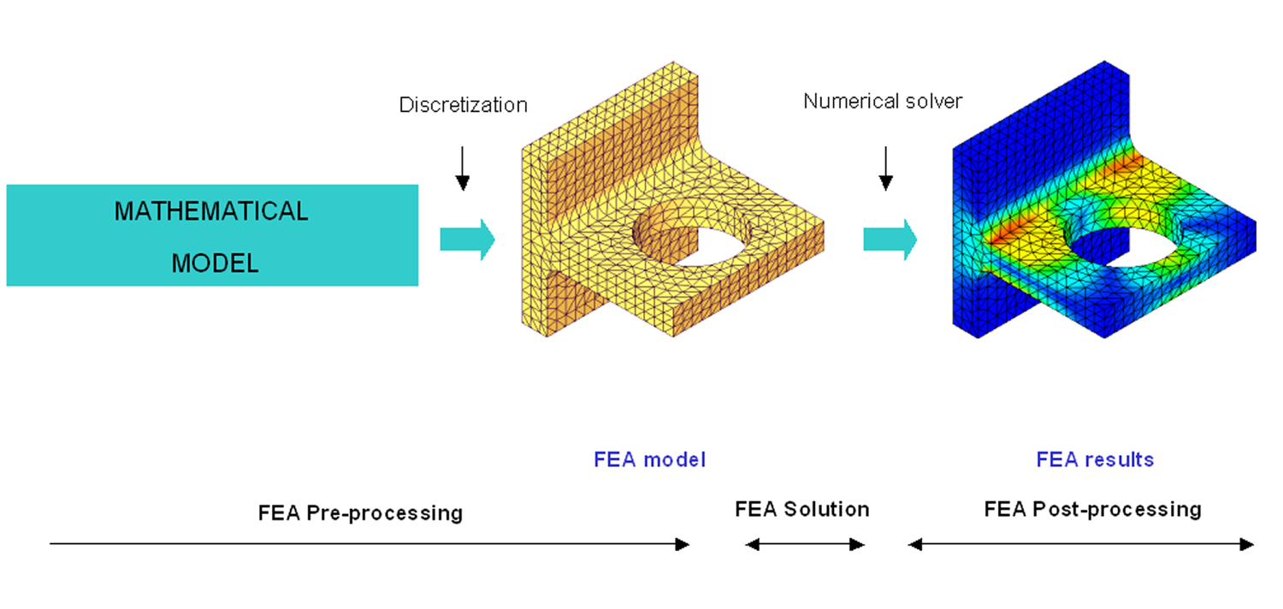
Build Finite Element Model

Slide 17
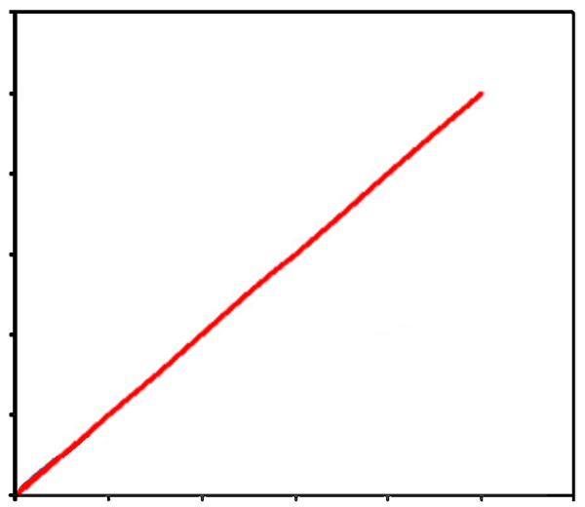
Limitations of SolidWorks Simulation
Material is linear
  Stress is proportional to Strain
  Slope of curve is Young’s Modulus (Modulus of Elasticity)

Slide 18
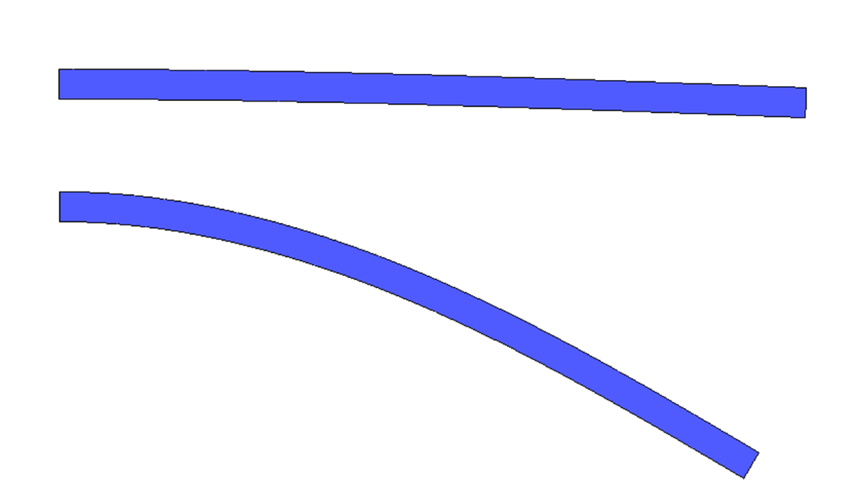
Limitations of SolidWorks Simulation
Deformations are small
  Deformation normally
  less than 5%
Loads are static
  Slowly applied
  Non-changing
Small Deformation
Large Deformation

Slide 19
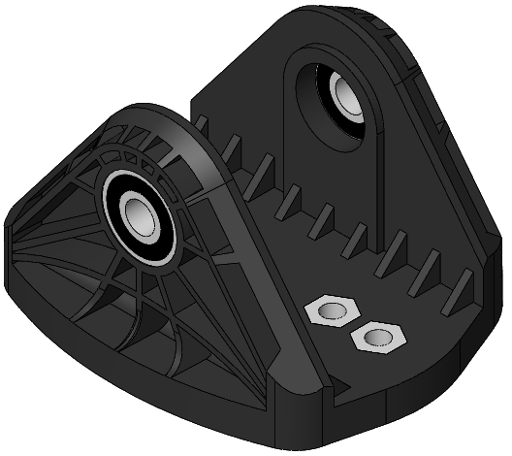
The Truck
The Truck holds the King Pin which is the shaft around which the Axle pivots.

Slide 20
Design Intent
One face mounts solidly to the Deck
Bearings mounted to allow King Pin to pivot
Hex nuts will be molded into the Truck for suspension adjustment

Slide 21
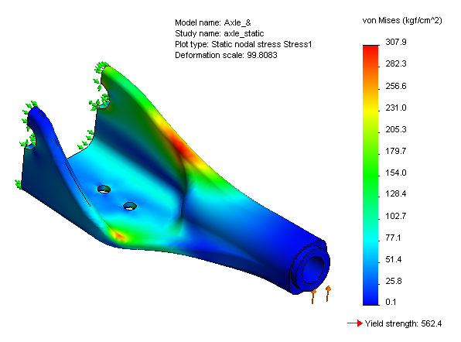
Stress Results

Slide 22
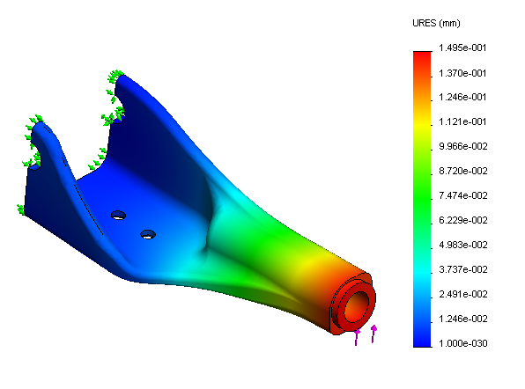
Displacement Results

Slide 23
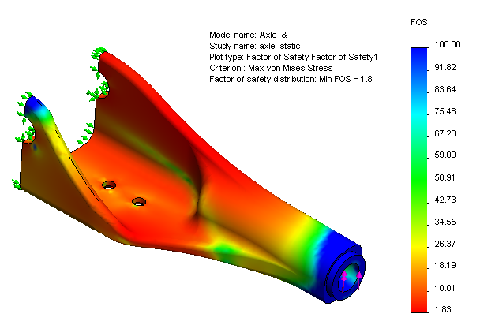
Factor Of Safety

